Slide 1
Advanced Data Structures: Linked Lists
Week 11 | Lecture 2 (11.2)

Slide 2
This Week’s Content
Lecture 11.1
More OOP! Encapsulation and Examples
Lecture 11.2
Advanced Data Structures: Linked Lists
Lecture 11.3
Design Problem! Gaussian Elimination

Slide 3

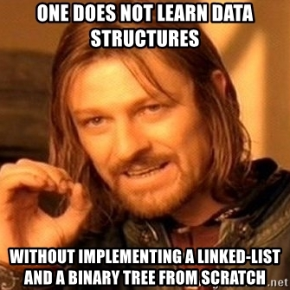
Data Structures!
Data structures are “containers” that organize and group data
Lists
Sets
Tuples
Dictionaries
Linked lists
Binary trees

Slide 4

Linked Lists – Sequences of Things to Do

Slide 5
Linked Lists – How do we read comics?
1 | 2 | 3 | 4

Slide 6
Linked Lists – How do we read comics?
1 | 2 | 3 | 4
Linear | Collection | Data | Elements
Linked | List

Slide 7
Linked Lists – How do we read comics?
NODE 1
NODE 2
NODE 3
NODE 4
1 | 2 | 3 | 4
Linear | Collection | Data | Elements
Linked | List

Slide 8
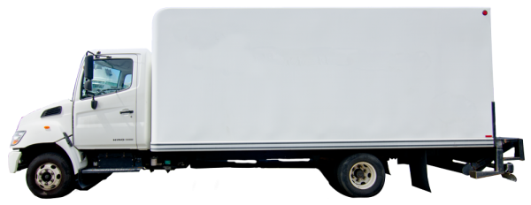
Linked Lists!
Linked lists are a linear collection of data elements made up of nodes
A node contains a link to the next node in the list, and some unit of data (i.e. str, int, list, set, etc.) that we will call the cargo
The last node in a linked list is None and does not provide a link to any other nodes
The beginning of the LL is called the ”head” and the end is the “tail”
HEAD
TAIL
node1
node2
node3
cargo item1
next
cargo item2
next
cargo item3
next None

Slide 9
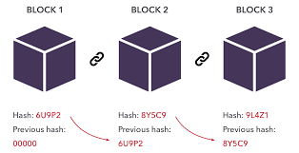

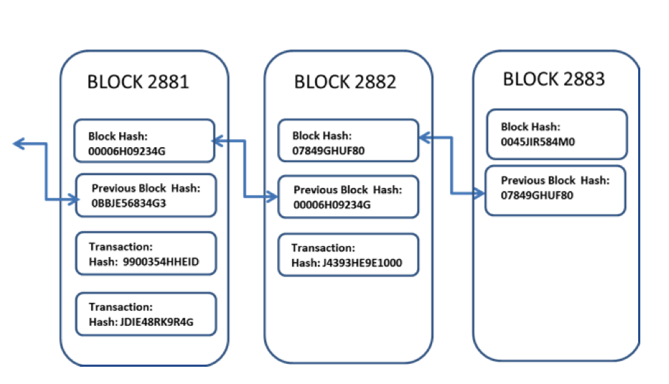

Sound familiar to anyone?
What if…
Cargo = transaction data?
Node = block?
Link = chain?

Slide 10


Linked List Advantages
Traffic jam entering Toronto
Advantages
Can dynamically shrink or grow at run-time
Other programming languages require to define the length of array upon creation, leading to wasted space unless it’s full
Faster insertion and deletion
No need to shift every element afterwards
Efficient memory management
Does not need to store elements sequentially (or contiguously) in memory
Implementation of data structures
Helpful for representing queues and stacks
Civil engineers model this!
A line (or queue) waiting for COVID rapid tests in Union Station

Slide 11


Linked List Disadvantages
Disadvantages
More memory used for each element
Must store its own cargo AND the pointer to next node
Random access
Because storage is not contiguous, you must traverse through all nodes to access content at node X, whereas you can directly index a list/array with list[X]
No easy way for reverse traversal
A “doubly-linked list” solves this by having a pointer to both previous and next nodes, but consumes more memory

Slide 12
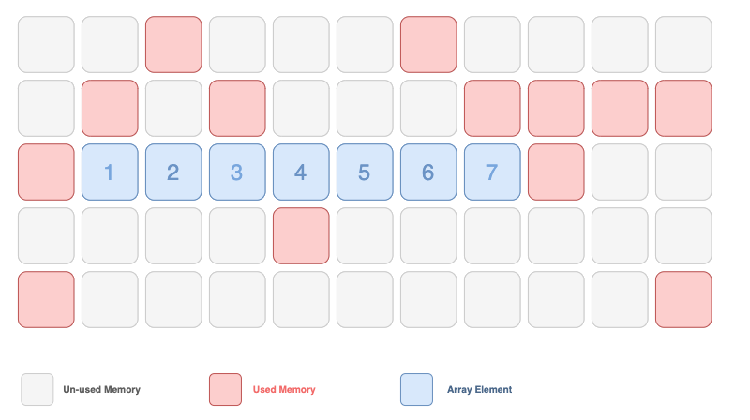
Contiguous (beside each other) Storage

Slide 13
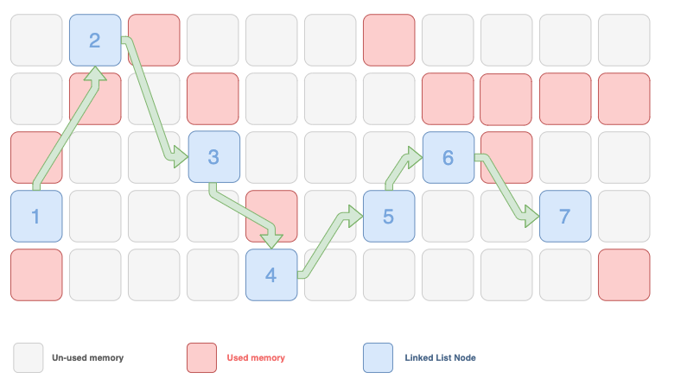
Non-contiguous Storage

Slide 14
Why Linked Lists? Modeling a Queue
my_list
item1 | item2 | item3 | item4
my_list.append(item5)
item1 | item2 | item3 | item4 | item5
1 operation
item1
my_list.pop(0)
 | item2 | item3 | item4 | item5
item2 | item3 | item4 | item5
# of operations proportional to length of list

Slide 15
Why Linked Lists? Modeling a Queue
HEAD
TAIL
node1
node2
node3
cargo item1
next
cargo item2
next
cargo item3
next None

Slide 16
Why Linked Lists? Modeling a Queue
HEAD
TAIL
cargo item1
next
cargo item2
next
cargo item3
next None
node1
node2
node3
Remove a node from the beginning
1 operation
HEAD
TAIL
cargo item1
next
cargo item2
next
cargo item3
next None
node1
node2
node3

Slide 17
Why Linked Lists? Efficient Insertion
my_list
item1 | item2 | item3 | item4
my_list.insert(2, item2.5)
HELP: insert(index, element)
item1 | item2 | item3 | item4
item1 | item2 |  | item3 | item4
item1 | item2 | item2.5 | item3 | item4
# of operations proportional to length of list

Slide 18
Why Linked Lists? Efficient Insertion
HEAD
TAIL
cargo item1
next
cargo item2
next
cargo item3
next None
node1
node2
node3
Insert new_node after node1
cargo item1
next None
new_node

Slide 19
Why Linked Lists? Efficient Insertion
HEAD
TAIL
cargo item1
next
cargo item2
next
cargo item3
next None
node1
node2
node3
Insert new_node after node1
HEAD
TAIL
cargo item1
next
cargo item2
next
cargo item3
next None
node1
node2
node3
cargo item1
next
new_node

Slide 20
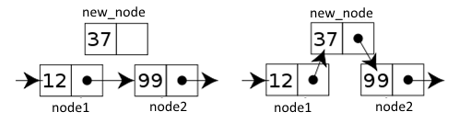
Efficient Insertion

Slide 21
Why Linked Lists? Efficient Deletion
my_list
item1 | item2 | item3 | item4
my_list.remove(item2)
item1 | item2 | item3 | item4
item1 |  | item3 | item4
item1 | item3 | item4
# of operations proportional to length of list
item1 | item3 | item4

Slide 22
Why Linked Lists? Efficient Deletion
HEAD
TAIL
cargo item1
next
cargo item2
next
cargo item3
next None
node1
node2
node3
Delete node2

Slide 23
Why Linked Lists? Efficient Deletion
HEAD
TAIL
cargo item1
next
cargo item2
next
cargo item3
next None
node1
node2
node3
Delete node2

Slide 24
The Node Class
Let’s use our knowledge of classes to prepare a linked list data structure in Python.
First, we need to make a node class.
We need __init__ and __str__ methods so we can create and display our new type
class Node:
def __init__(self, cargo=None, next=None):
self.cargo = cargo
self.next = next
def __str__(self):
return str(self.cargo)

Slide 25
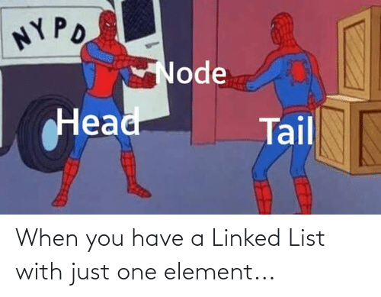
The Node Class
The string representation of a node is just the string representation of the cargo
To test the implementation so far, we can create a node a print it:
BUT, a linked list needs more than one node!
>>> node = Node("test")
>>> print(node)
test

Slide 26
The Node Class
To make a linked list, we need more than one node:
What’s wrong here?
>>> node1 = Node(1)
>>> node2 = Node(2)
>>> node3 = Node(3)
cargo 1
next None
cargo 2
next None
cargo 3
next None
node1
node2
node3
These nodes aren’t linked!

Slide 27

The Node Class
To link the nodes, we have to make the first node refer to the second and the second node refer to the third
The reference of the third node is None, which indicates the end of our linked list
>>> node1.next = node2
>>> node2.next = node3
cargo 1
next
cargo 2
next
cargo 3
next None
node1
node2
node3
These nodes are now linked!

Slide 28
The Node Class
Now we’ve assembled multiple objects into a single entity: a collection
Recall the beginning node we refer to as the head. This head serves as a reference to the entire collection
To pass our linked list as a parameter, we only have to pass the reference to the first node, or our head node
HEAD
cargo 1
next
cargo 2
next
cargo 3
next None
node1
node2
node3
These nodes are now linked!

Slide 29

Breakout Session!
Let’s look at how this works in Python!
Node class
Creating nodes
Setting cargo and next pointers
Open your notebook
Click Link:
1. The Node Class

Slide 30
Traversing a Linked List
Let’s write a function print_list that takes a single node as an argument (usually the head), and prints each node until it gets to the end (tail) of that linked list
class Node:
def __init__(self, cargo=None, next=None):
self.cargo = cargo
self.next = next
def __str__(self):
return str(self.cargo)
node1 = Node(1)
node2 = Node(2)
node3 = Node(3)
node1.next = node2
node2.next = node3
>>> print_list(node1)
1 2 3
def print_list(node):
while node != None:
print(node, end=" ")
node = node.next
OR while node:

Slide 31
Traversing a Linked List
To call this method, we pass a reference to the first node
Inside print_list we have a reference to the first node of the list, but there is no variable that refers to the other nodes. We have to use the next value from each node to get to the next node
What would happen if we put node2 instead of node1?
>>> print_list(node1)
1 2 3
>>> print_list(node2)
2 3

Slide 32
Infinite Lists
There is nothing stopping a node from referring back to an earlier node, including itself
If we try to print this list, it will loop forever
print_list should come with a pre-condition that no node references a node earlier in the sequence
HEAD
cargo 1
next
cargo 2
next
node1
node2

Slide 33

Let’s Code!
Let’s look at how this works in Python!
Traversing a Linked List
Printing a list
Modifying a Linked List
BREAKOUT SESSION!
Open your notebook
Click Link:
2. Traversing Linked Lists

Slide 34
Advanced Data Structures: Linked Lists
Week 11 | Lecture 2 (11.2)

